Slide 1


MOVIE PRODUCTION ANALYSIS
Movie Production Analysis

Slide 2
About me
My self Dhiraj Rathod and I am BTech computer Engineering Graduate.
Link-din : https://www.linkedin.com/in/dhiraj-rathod-99a42326a/
Git-hub : https://github.com/dhirajrathod1409

Slide 3
Business Problem
Analyzing IMDb Ratings of Movies to Guide Investment Decisions for a Film Production Company.
A film production company wants to maximize its return on investment (ROI) by producing movies that are likely to receive high IMDb ratings (a strong indicator of audience reception and long-term success).
Approach (How to Solve it?)
Web Scraping
Data analysis

Slide 4
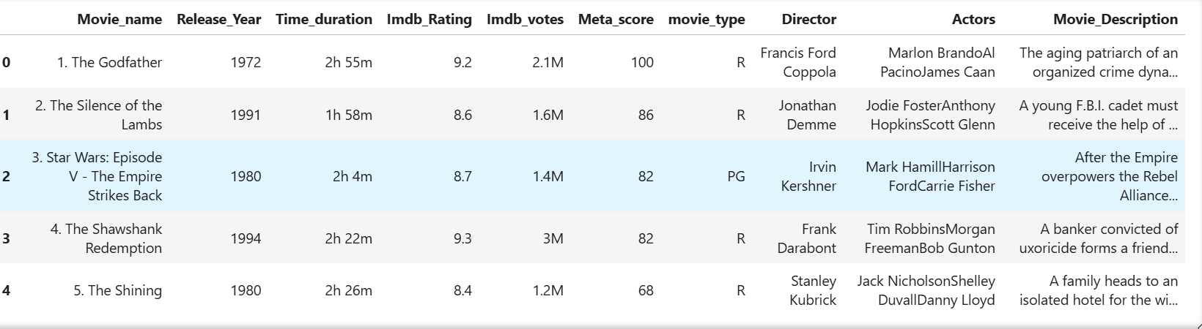
What does Dataset Contains?
Movie name - Name of movie rated on platform.
Release year - Release year of movie rated .
Time duration - How long rated movie is ?
IMDB rating - Correlate with box office success and streaming popularity and score lies between [1 – 10]
IMDB votes - Represent user ratings for movies and TV shows, on a scale of 1 to 10, with higher scores indicating a higher level of appreciation
Meta score - as used on Metacritic, is a single score (out of 100) representing the critical consensus for a game, movie, TV show, or album.
Movie type – what type of movie is it ?R , G or PG etc.

Slide 5
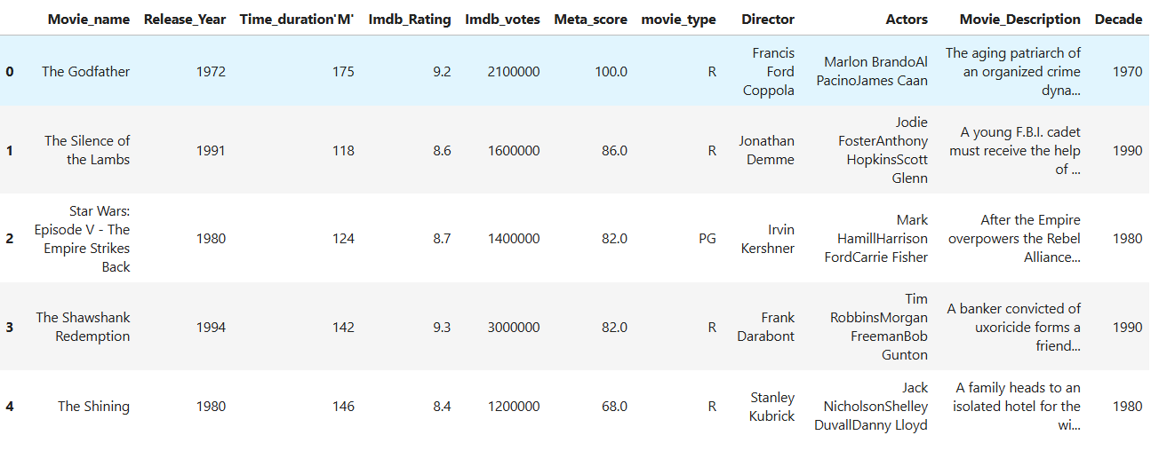
Data cleaning, Manipulation and Transformation
While scraping the data some values are missing ,handling those missing value .
Transform different feature like rating , IMDB votes , Meta score , time duration , release year from string to numerical value.
Create a new feature Decade from duration column , showing movie belongs to which decade .
After all cleaning structure dataset :

Slide 6
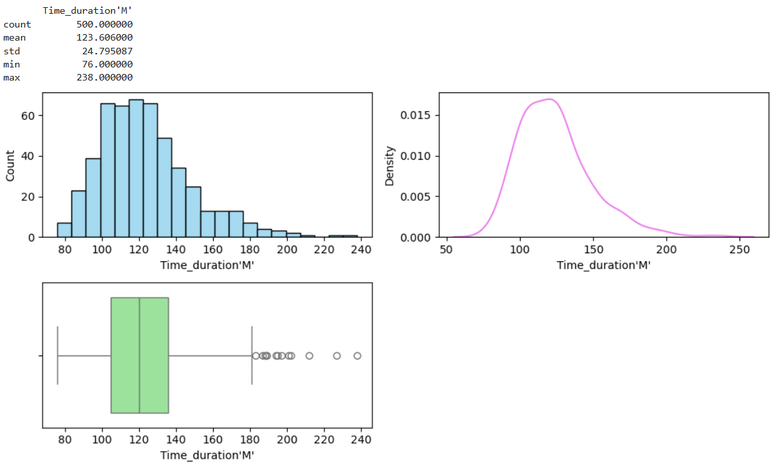
Exploratory Data Analysis Univariate analysis
Analysis of Time duration of Movies
Most of the movies of these dataset having time duration is between 100 and 140 Min.
Some outlier or extremities are also there some movies have long duration greater than 180.

Slide 7
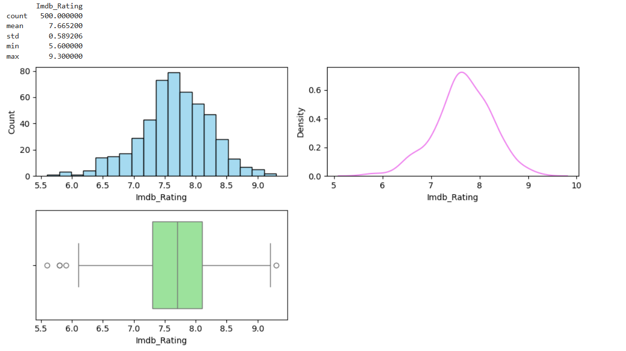
Analysis of IMDB Rating
Most of Movies having rating are in between 7.5 and 8
Some extrem values are also there below 6

Slide 8
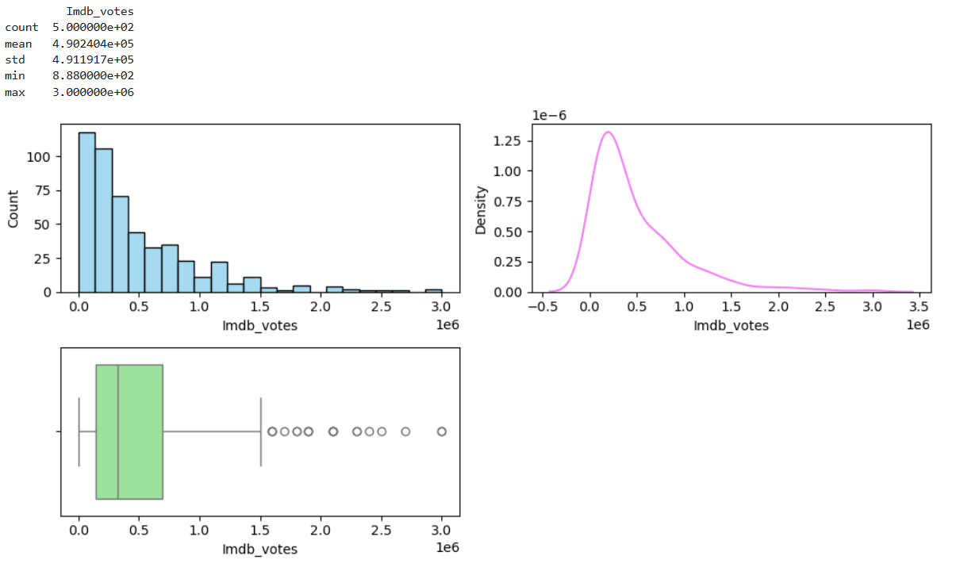
Analysis of IMDB votes
Observation:
Most of the movies have earn votes in between 100000 and 500000 votes.
Outlier are also present in this column showing some movies also have votes more 1.5 million votes.

Slide 9
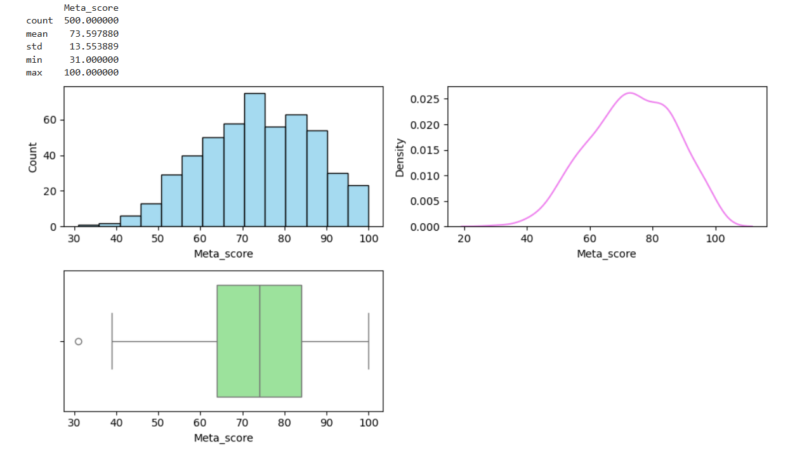
Analysis of Meta score
Observation:
most of the movies have meta score between 65 and 85
some lower bound outlier are also there in this column.

Slide 10
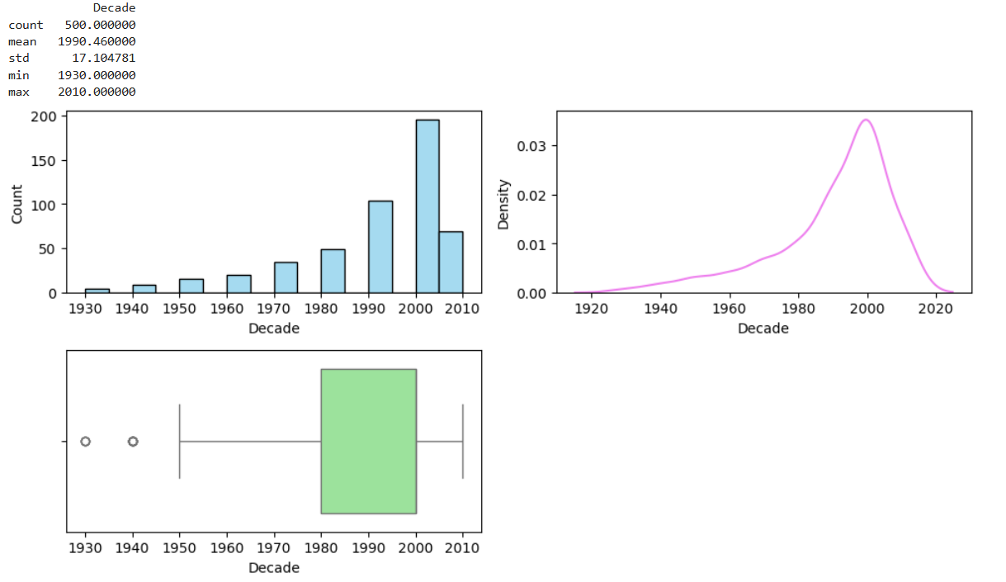
Analysis of Decade
Observation:
Most of the movies of this dataset is of 1980-2000 decade
some lower bound outlier movies are also present below 1950's Decade.

Slide 11
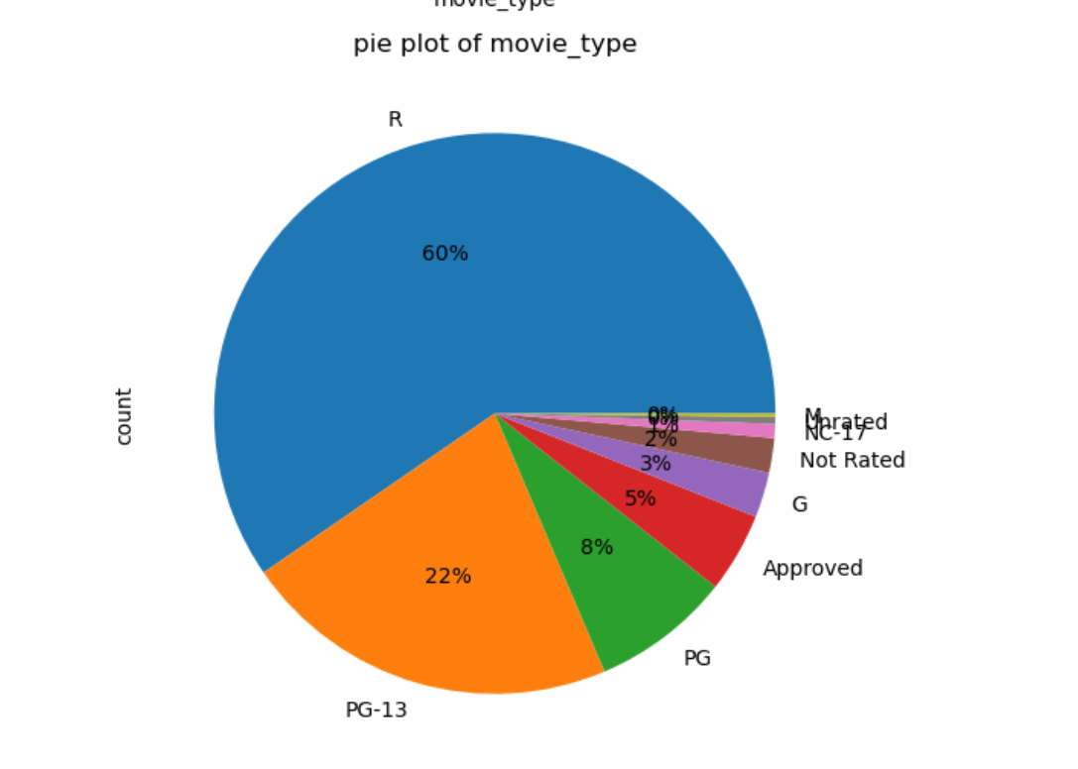
Analysis of Movie type
Observation :
most of the movies are R rated movies

Slide 12
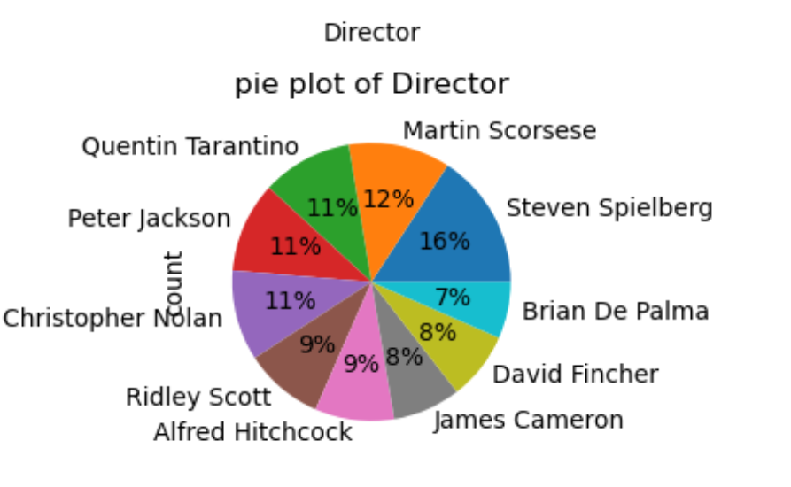
Analysis of Director
Observation :
Director appear in high rated movies.

Slide 13
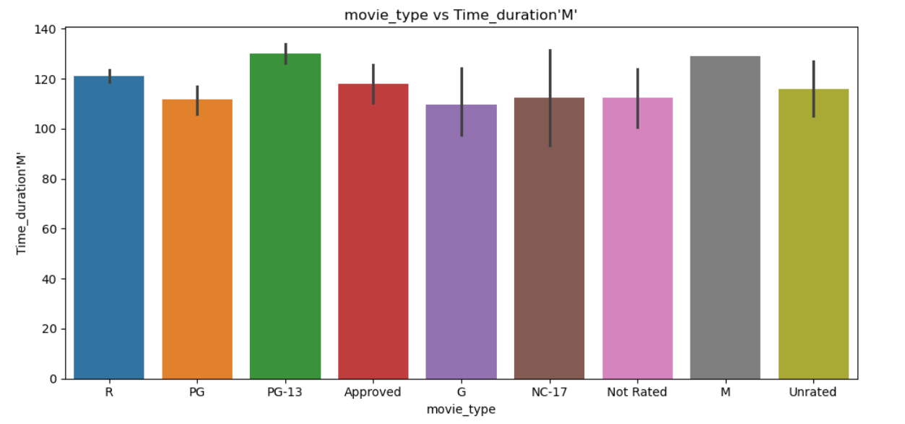
Bivariate analysis movie type vs Time duration
Observation:
G type movies having low time duration

Slide 14
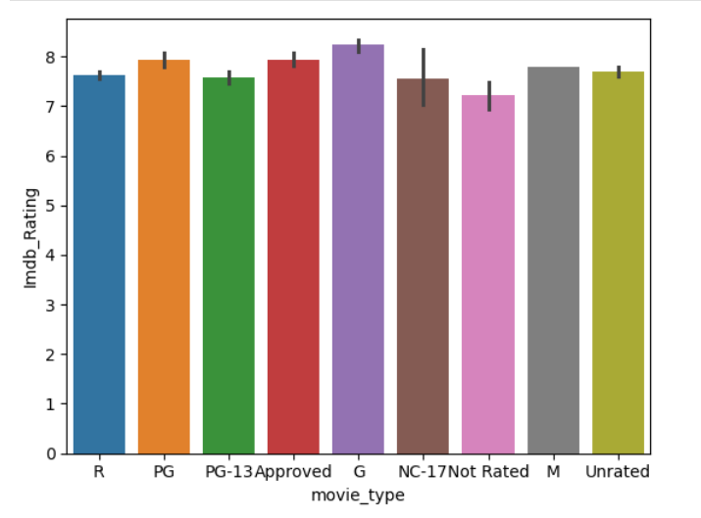
Movie type vs IMDB rating
Observation:
G type movie having max IMDB rating than any other type of movies.

Slide 15
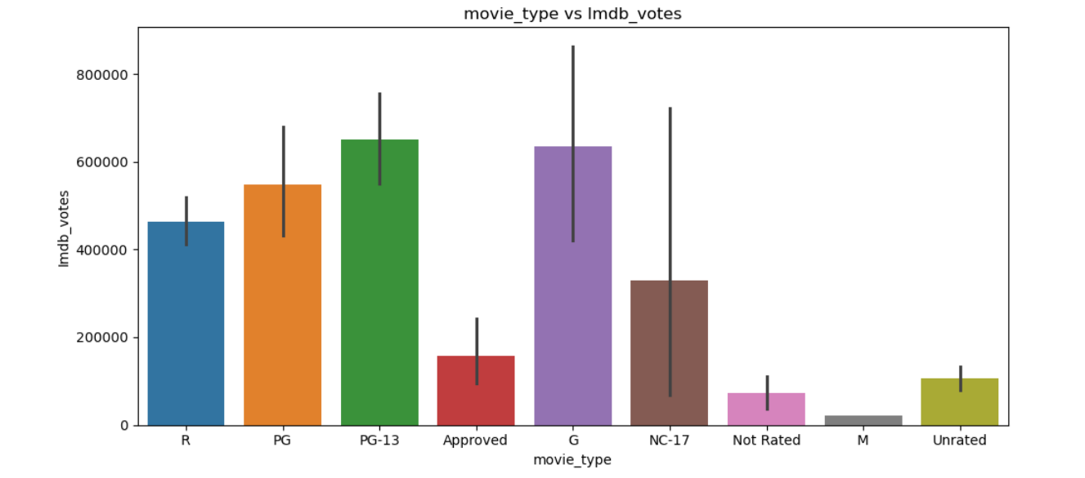
Movie type vs IMDB votes
Observation:
G type movie having maximum IMDB votes

Slide 16
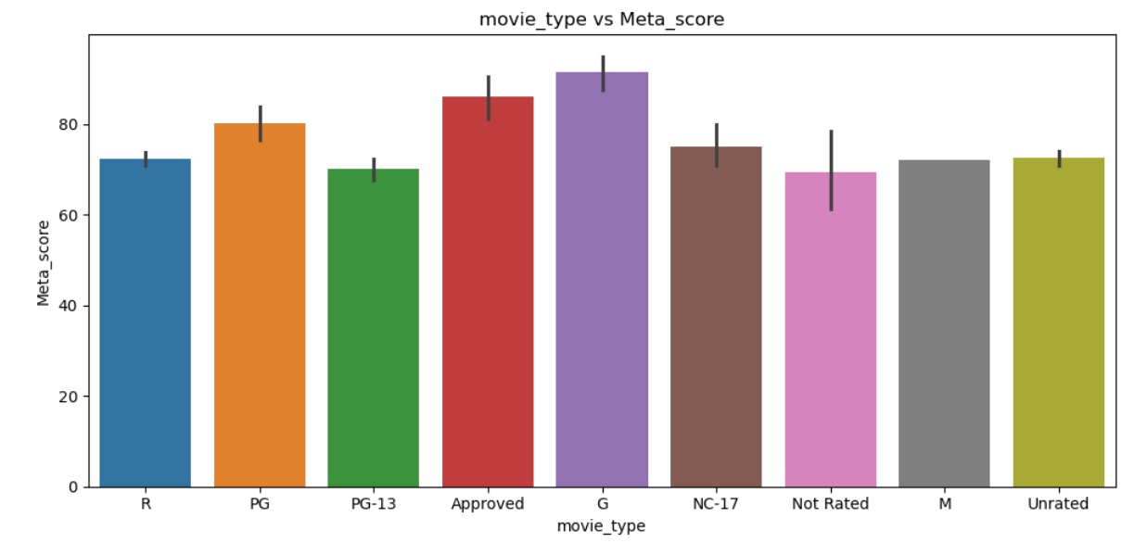
Movie type vs Meta score
Observation:
G type movie having high meta score than other movie type.

Slide 17
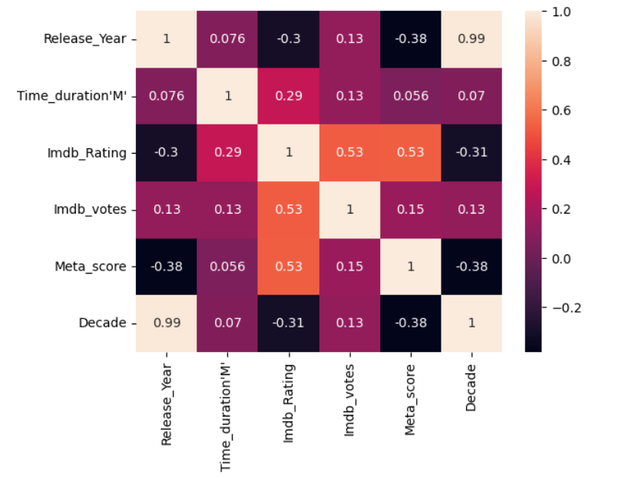
Multivariate Analysis
Observation:
IMDB Rating has positive correlation with meta score and IMDB votes column of 0.6

Slide 18
Final Business Recommendations
Produce R or PG-13 films (highest rating potential).
Hire top directors (Nolan, Tarantino, Spielberg) or rising talents with strong track records.
Keep runtime between 120–150 minutes for optimal engagement.
Also from analysis we can produce G type films as it receive high Imdb votes and its duration is also small .
Avoid over-reliance on sequels/reboots (original stories tend to rate higher).

Slide 19

THANK YOU

